Slide 1
My Old Workplace
Tomoya Yamanaka

Slide 2
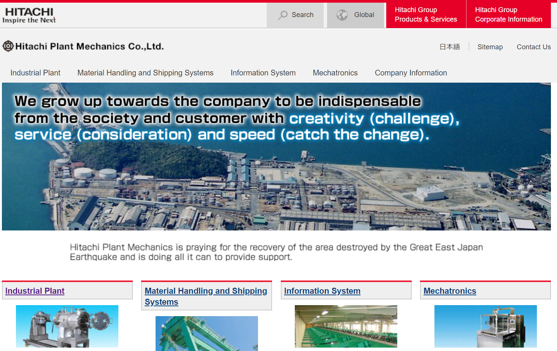
I was working in this company
I was working in this company and enjoying but we had a problem for no more young employee coming. Don’t you want to work in such company?
https://www.hitachi-hpm.co.jp/en/

Slide 3
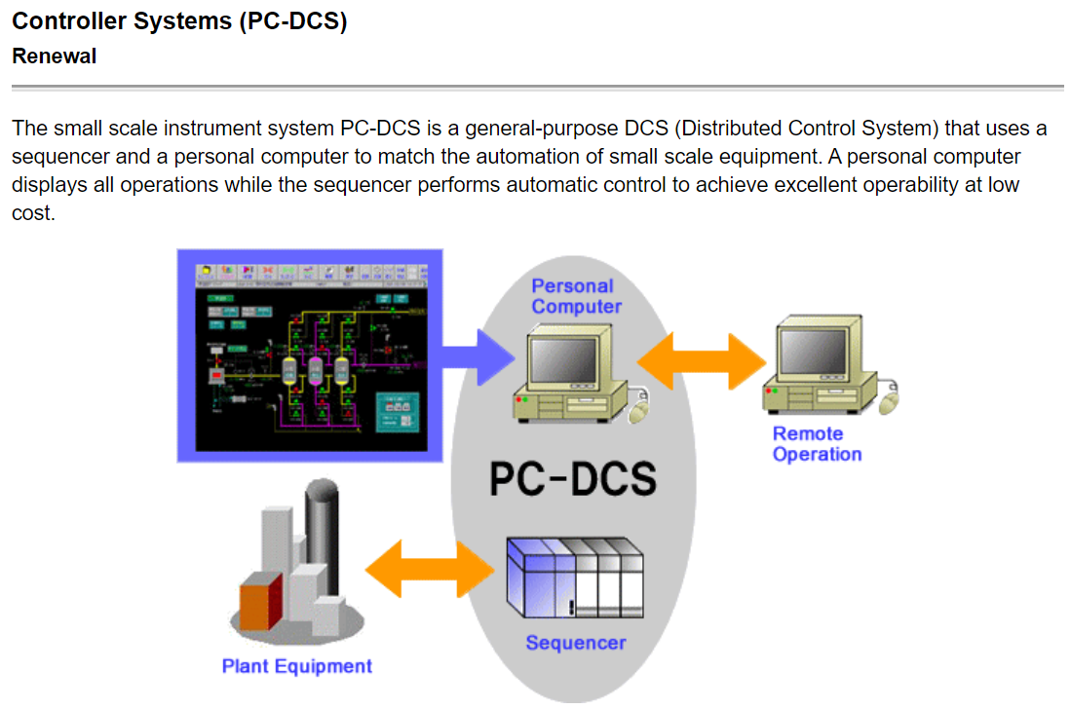
DCS, a system for a factory
I was working on this system. Our company wants to make our own version of it in future.
https://www.hitachi-hpm.co.jp/en/plant/product/pc_dos/index.html

Slide 4
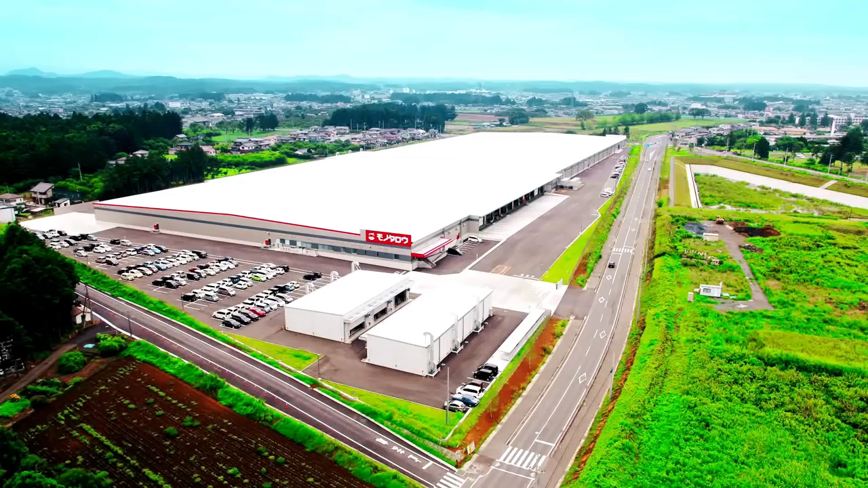
Racrew(ラックルー)
https://www.youtube.com/watch?v=LbVQL6WCDkc

Slide 5

HiMoveRO(ハイモベロ)
https://www.hitachi-hpm.co.jp/mechatronics/HiMoveRO/index.html

Slide 6
END

